Slide 1

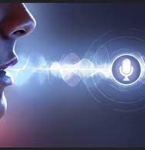
DESKTOP ASSISTANT

Slide 2
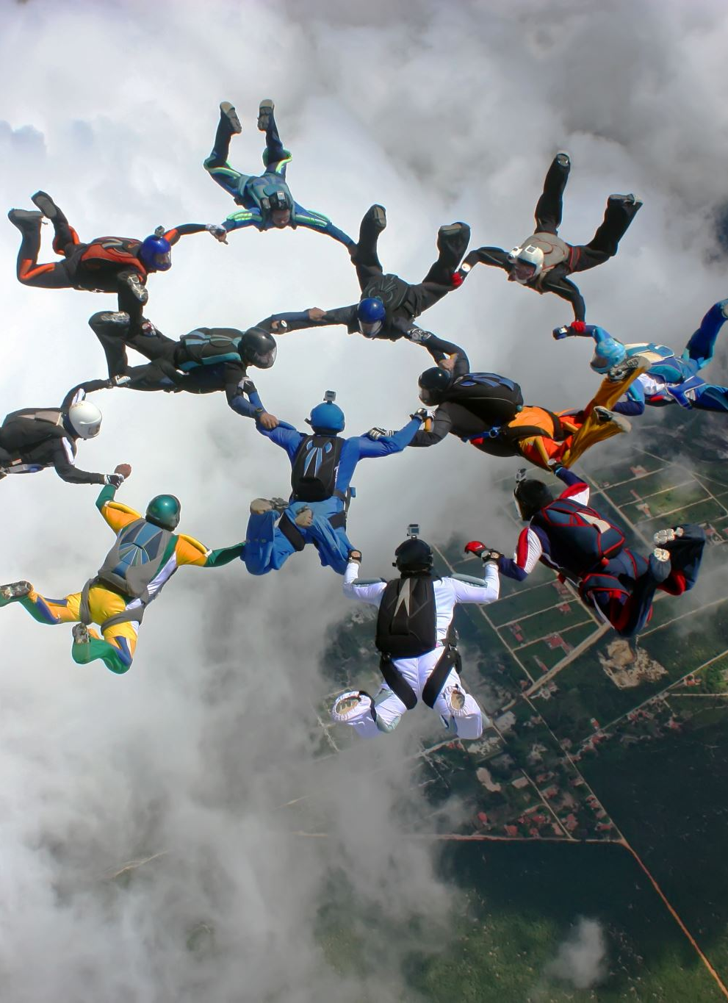




Team Leader : Shreyansh Tyagi
Team Member :Sneha Singhal
Mentor : Mr. Ankit Verma

Slide 3
INTRODUCTION
A virtual assistant is a technology based on artificial intelligence
The software uses a device’s microphone to receive voice requests while the voice output takes place at the speaker. But the most exciting thing happens between these two actions.
It is a combination of several different technologies
voice recognition, voice analysis and language processing.
It is completely developed using one of the most powerful language python.

Slide 4
Basic Concepts Used
The working of desktop assistant uses the basic following principles:
To understand user’s speech input.
Automatic speech recognition
To understand command according to users input.
Artificial intelligence
To learn things from user and to store all the information , behavior and relation of users.
Intel process communication
To get important information from other software.

Slide 5
FEATURES
Translation
Search word from Dictionary
Change voice
Date, Time, Temperature
Play Music & Videos
Whatsapp Messages & Emails
Screenshots
Open & Close Applications
Youtube & Google Automation
Keyboard Control
Network Speed Test
Volume Control
OS Information

Slide 6
Working
Speech to text
Text Analyising
Interpret Commands

Slide 7
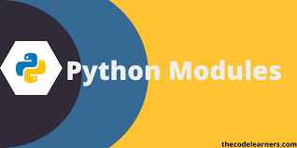
MODULES USED

Slide 8
Pyttsx3:-
This module is used for conversion of text to speech in a program. It works offline.
Speech Recognition:-
Speech recognition helps us to save time by speaking instead of typing. It also gives us the power to communicate with our devices without even writing one line of code.
Playsound :-
The playsound module is the simplest module to use for playing sound. This module is tested to play wav and mp3 files only.

Slide 9
Pynput
This library allows you to control and monitor input devices.
wordtodigits
To convert spoken words into digits.
Pydictionary
used to fetch the meaning of the word from the dictionary.
Pyqt5
PyQt5 has provided a tool called ‘QtDesigner’ to design the front-end by drag and drop method so that development can become faster and one can give more time on back-end stuff.

Slide 10
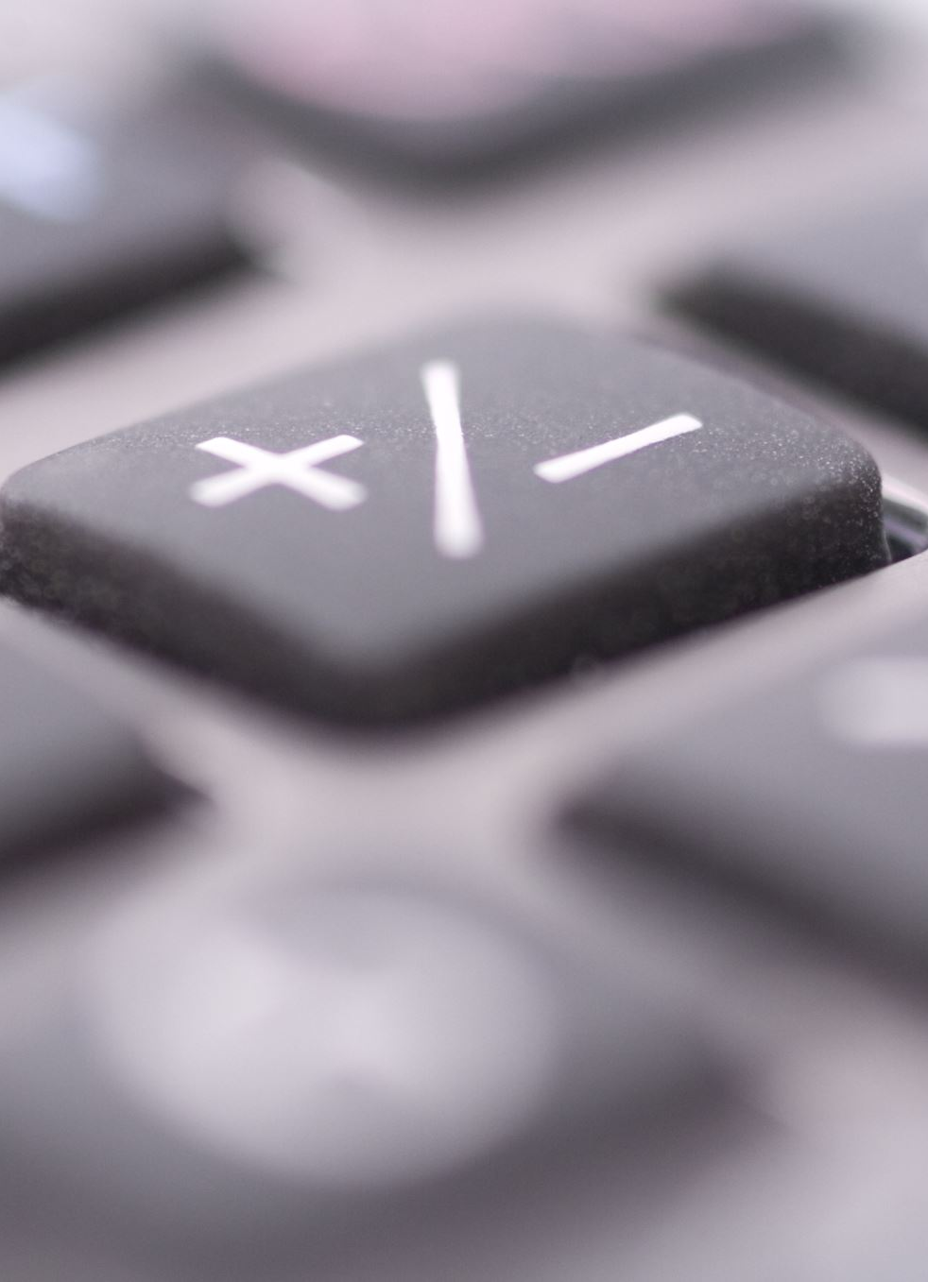
Bs4 :-
It works with your favorite parser to provide idiomatic ways of navigating, searching, and modifying the parse tree.
Pyautogui:-
PyAutoGUI is a cross-platform GUI automation Python module for human beings. Used to programmatically control the mouse & keyboard.
Keyboard:-
It helps to enter keys, record the keyboard activities and block the keys until a specified key is entered and simulate the keys. Using this module we can listen and send keyboard events.

Slide 11
Software Requirements
WebCam for motion detection
VSCode and jupyter Notebook
Web Browser for searching

Slide 12
Hardware Requirement
Internet Connectivity
A mobile phone is required to access the microphone of the computer
Operating System : Windows 8,10 and Linux(Ubuntu)
Min. 4 GB RAM and i3 and above processor

Slide 13
Functionalities of Desktop Assistant
CHATBOT GUI
MOTION DETECTION
FACE MASK DETECTION
DATA ANALYTICS & SCRAPPING

Slide 14
CHATBOT GUI
Tokenization
Stemming
bag_of_words

Slide 15
TOKENIZATION
Tokenization is the process by which a large quantity of text is divided into smaller parts called tokens. These tokens are very useful for finding patterns and are considered as a base step for stemming and lemmatization. for example:-sentence_data = The First sentence is about Python. The Second: about Django. You can learn Python,Django and Data Ananlysis here. ['The First sentence is about Python.', 'The Second: about Django.', 'You can learn Python,Django and Data Ananlysis here.']

Slide 16
STEMMING
Stemming is the process of producing morphological variants of a root/base word. Stemming programs are commonly referred to as stemming algorithms or stemmers. for example:- words = ["program", "programs", "programmer", "programing", "programmers"] [program,program,program,program,program]

Slide 17
Bag_of_Word
a Natural Language Processing technique of text modeling known as Bag of Words model. Whenever we apply any algorithm in NLP, it works on numbers. We cannot directly feed our text into that algorithm. Hence, Bag of Words model is used to preprocess the text by converting it into a bag of words, which keeps a count of the total occurrences of most frequently used words.

Slide 18
Modules Required
random​
It can be used to perform some action randomly such as to get a random number, selecting a random elements from a list, shuffle elements randomly
JSON
It will convert strings to Python datatypes,normally the JSONfunctions are used to read and write directly from JSON file.
PyTorch
​ A​n open source machine learning library used for applications such as computer vision and natural language processing.

Slide 19
FACE MASK DETECTION
Face Mask Detection is a real-time system to detect whether the person on the webcam is wearing a mask or not. We will train the face mask detector model using Keras and OpenCV. It will give green signal if a person is wearing mask and gives red signal if a person is not wearing a mask.

Slide 20
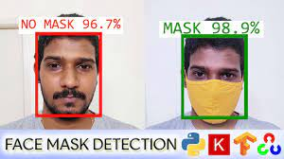

Slide 21
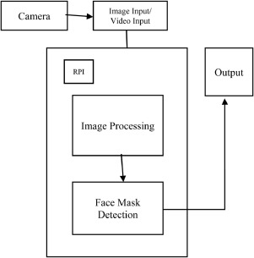
FLOWCHART

Slide 22
Library Used
Img_to_array
Preprocess_input
Open CV

Slide 23
FUTURE GOALS!
Motion Detection
Data Analytics & Visualization

Slide 24
CONCLUSION
Desktop assistant system will use the natural language processing and can be integrated with artificial intelligence techniques to achieve a smart assistant that can control the computer and applications and even solve user queries using web searches.
It can be designed to minimise the human efforts to interact with many other sub systems , which would otherwise have to be performed manually by achieving this the system will make human life comfortable.

Slide 25
THANK YOU!

